Slide 1
Employee Analysis
Tina Pai

Slide 2
Agenda
1) Job role insights
2) Model for Attrition
3) Model for Salary

Slide 3
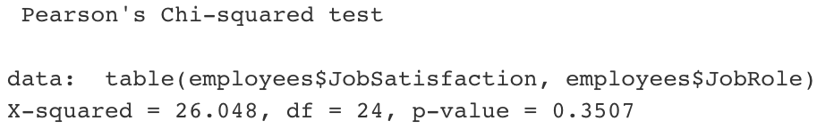
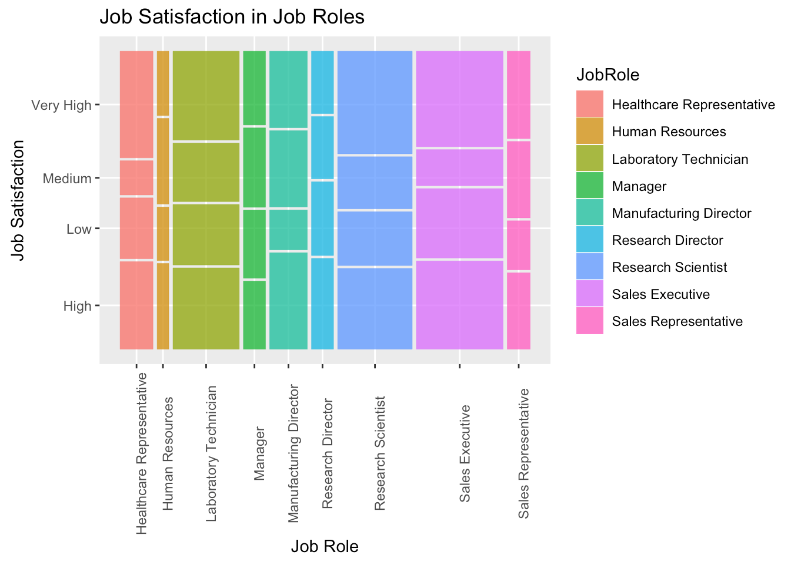
Job Role Insights
There is not a major difference in job satisfaction across job roles
Chi Squared p = .35

Slide 4
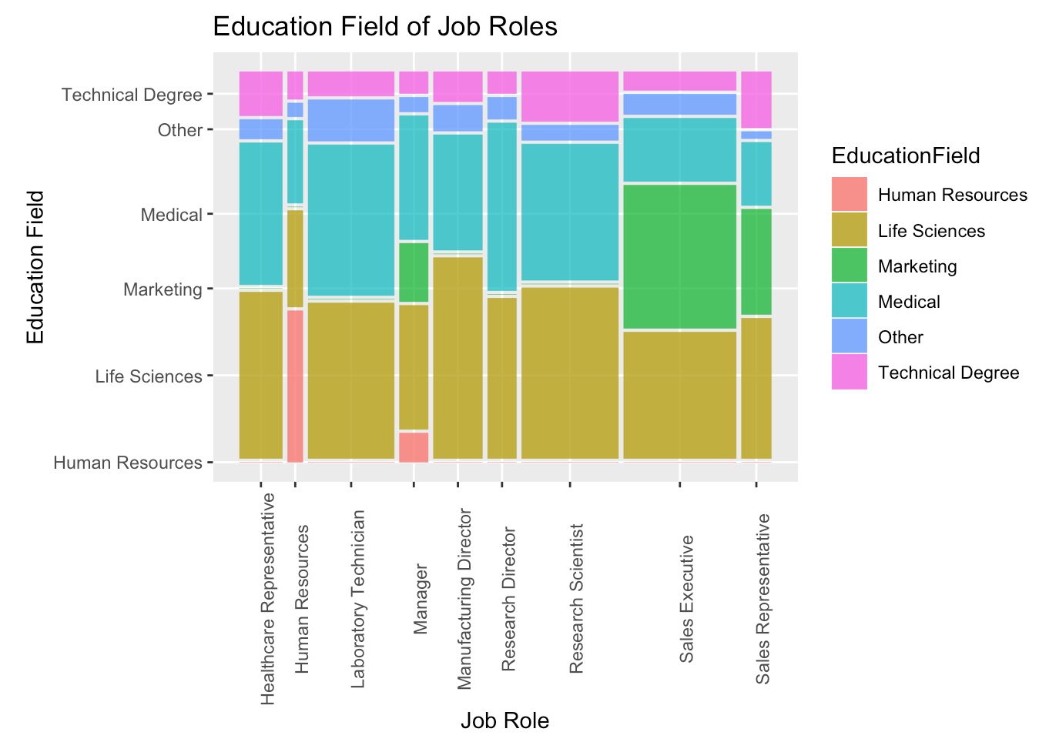
Job Role Insights
Education background is related to what job role people have
People in more technical roles come from STEM backgrounds more than people in less technical roles:
Those who got Marketing or Human Resources degrees were all either in HR, management, or sales
All the people in research-related jobs had science, medical, technical, or other degrees.

Slide 5
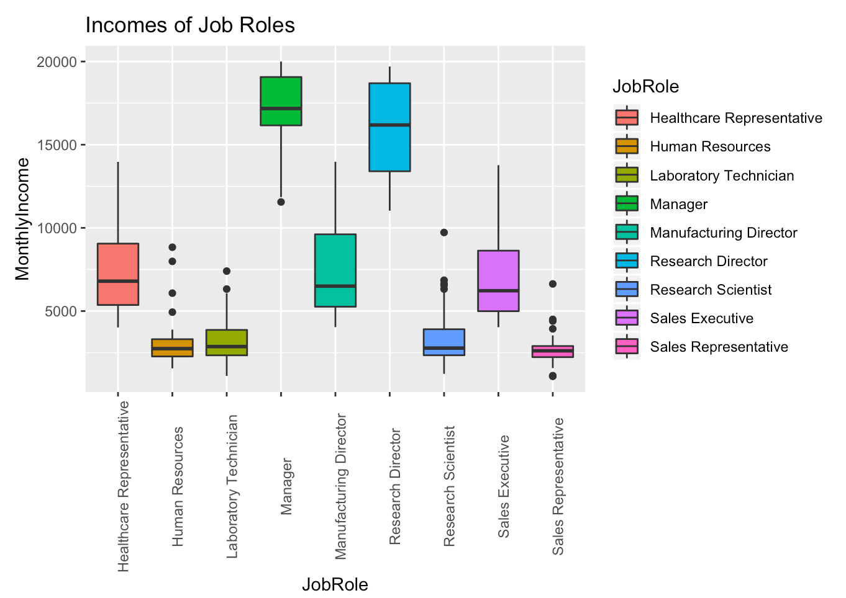
Job Role Insights
Income is very related to what job role people have
Least $: HR, lab technician, research scientist, and sales representatives
Middle $: Healthcare representatives, Manufacturing directors, and sales executives
Most $: Managers and Research directors make the most money.

Slide 6
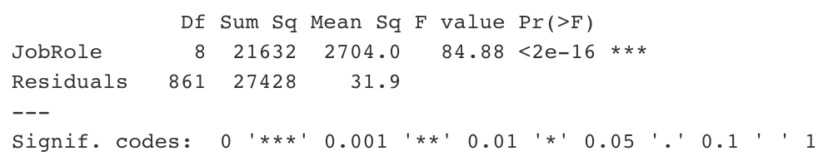
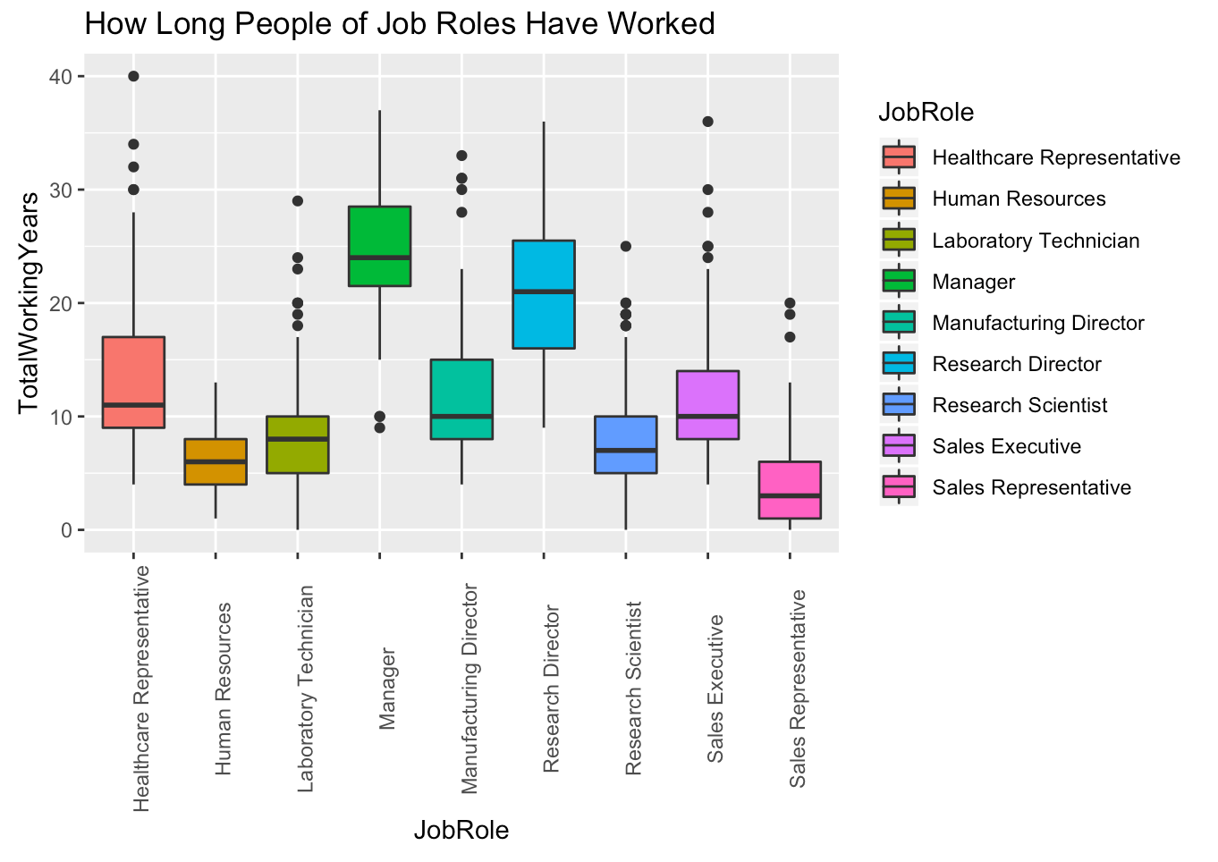
Job Role Insights
There is a difference across the job roles regarding how long people of these roles have been in the work force (p < 2e-16 from one-way ANOVA test).
Most entry-level: Sales representative and HR
Most experienced: manager and director

Slide 7
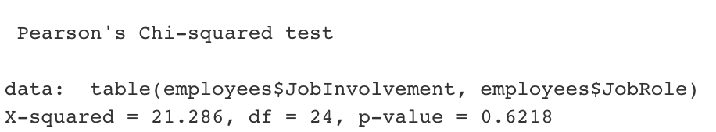
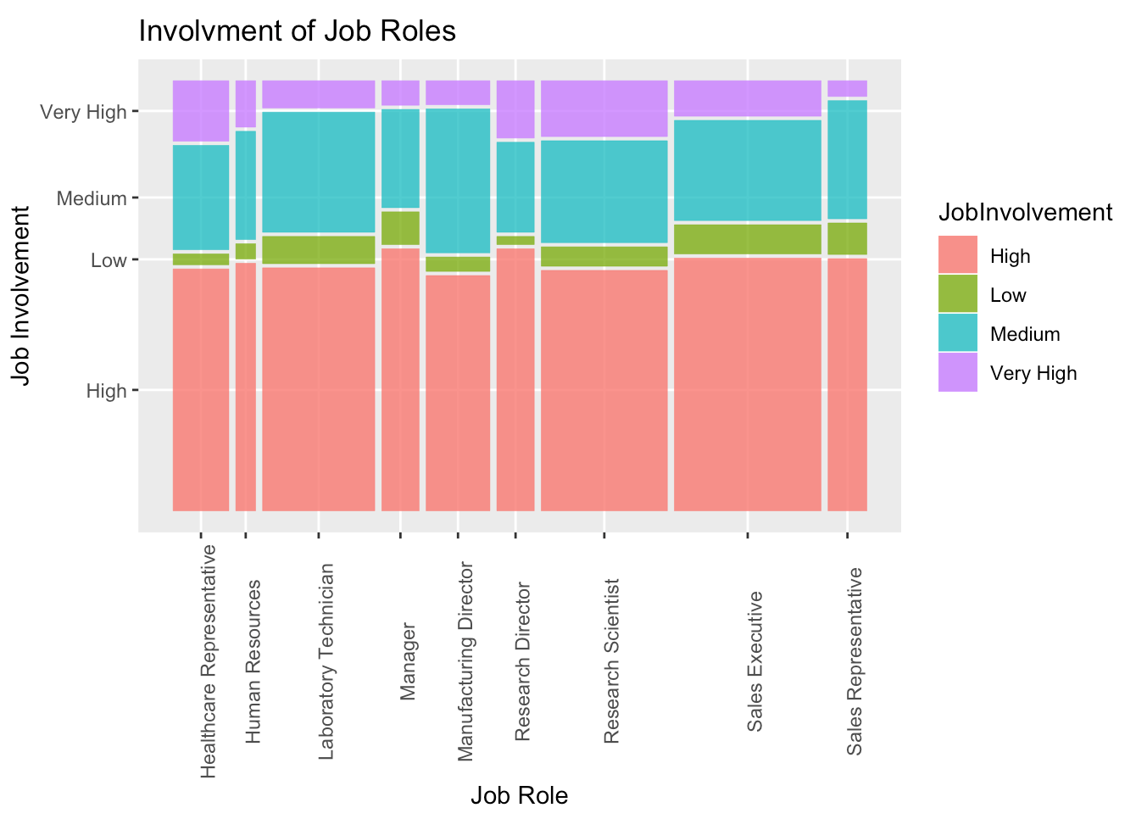
Job Role Insights
All the job roles are similar in their distribution of amount of job involvement, at least according to this data (p = .62 from Chi Square test)
We don’t have insight as to what the definitions of these job involvement level break outs are, so it is hard to interpret this deeply.
But later we’ll see job involvement important in predicting attrition

Slide 8
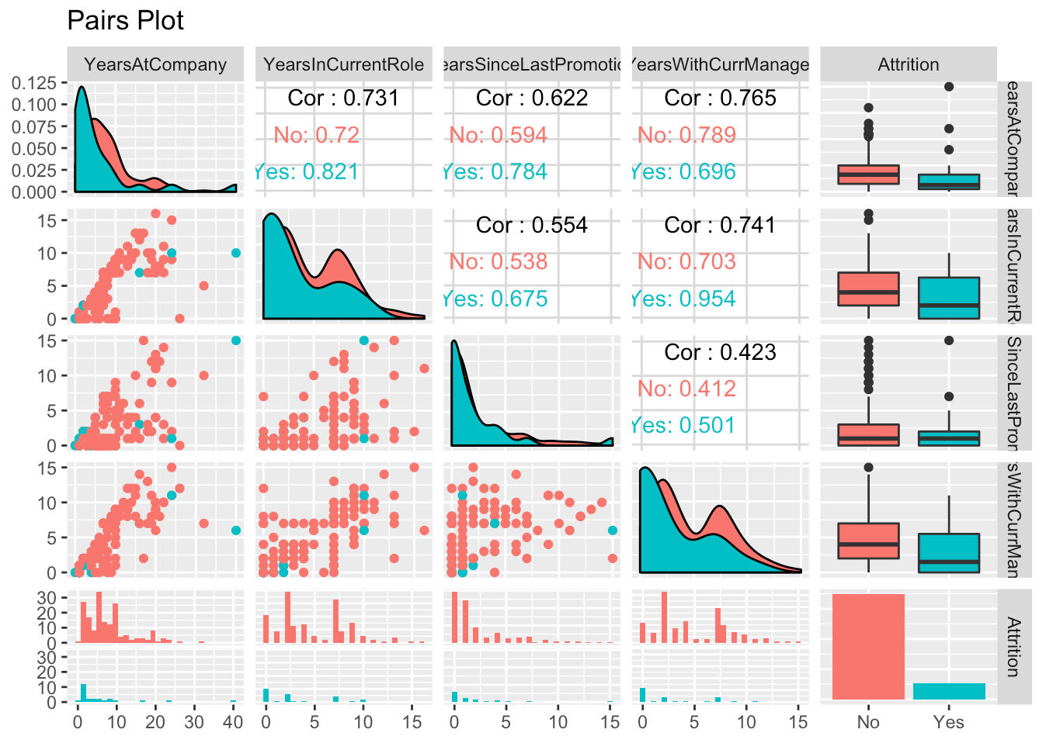
Predicting Attrition
No clear clusters of attrition-- attrition is scattered across the continuous variables
Attrition has some differences in distribution of variables related to length of time in a position
These variables are quite correlated with each other

Slide 9
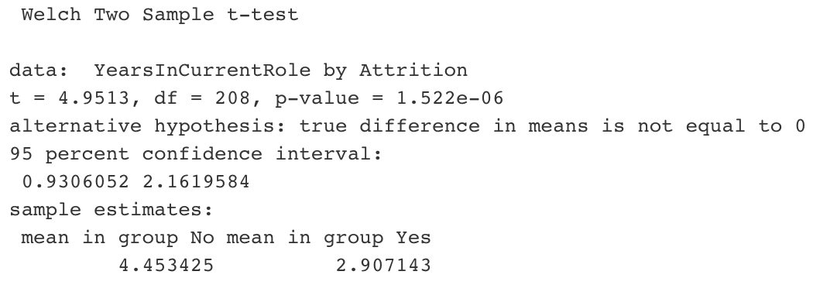
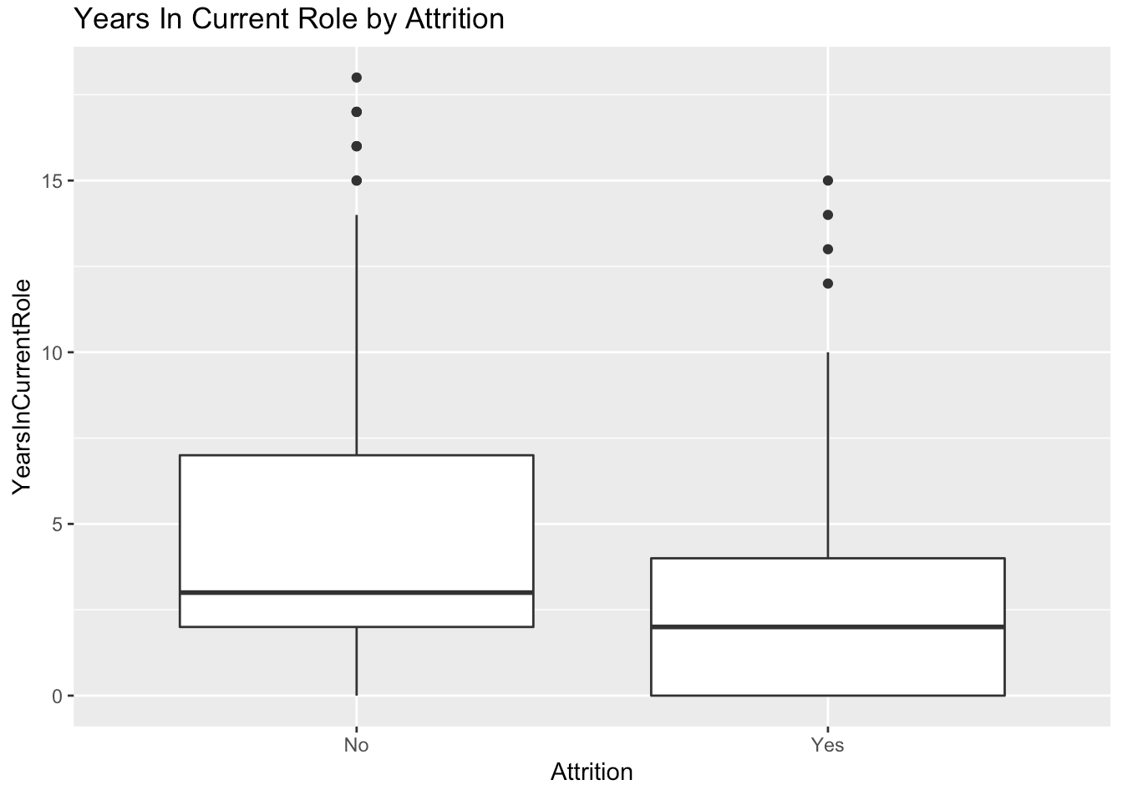
Predicting Attrition
Year in current role has a lower mean among those who did not leave the company (p value .000001 from T Test)
Yes population: ~ 0 – 4 yrs
No population: ~ 3 – 7 yrs

Slide 10
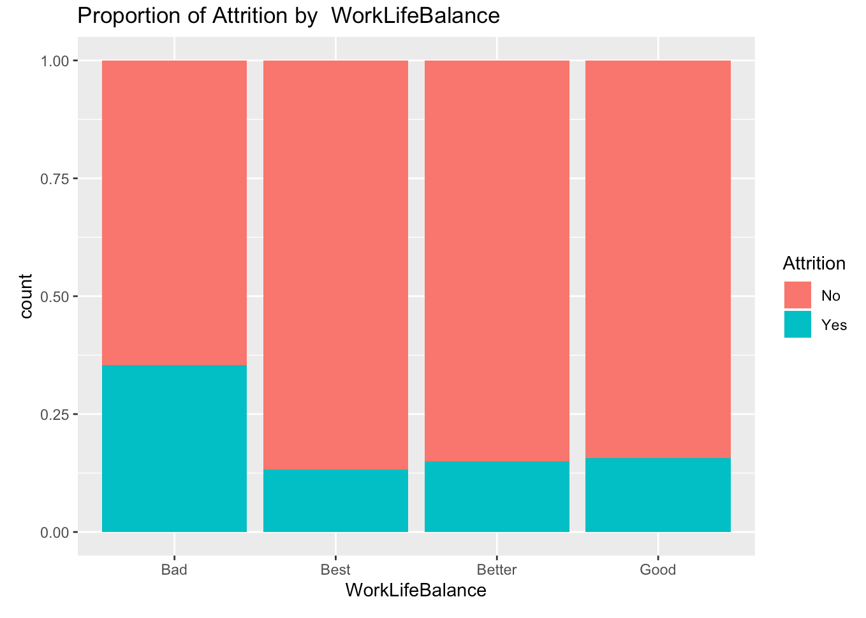
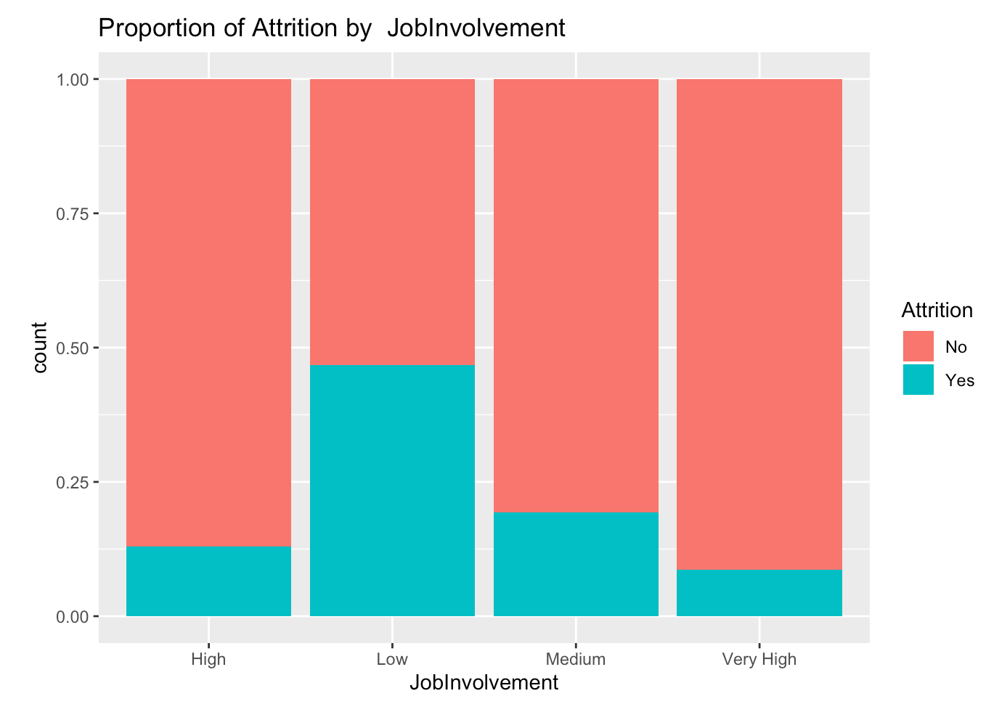
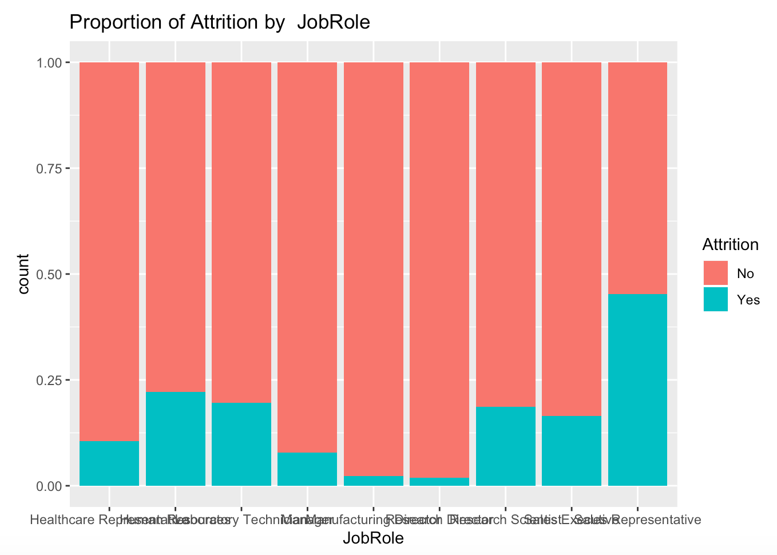
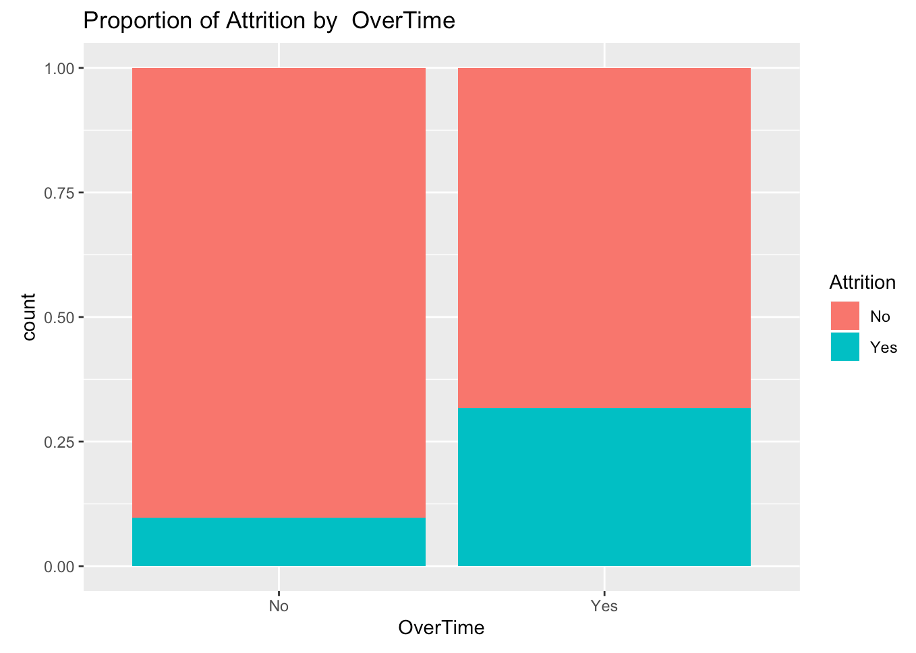
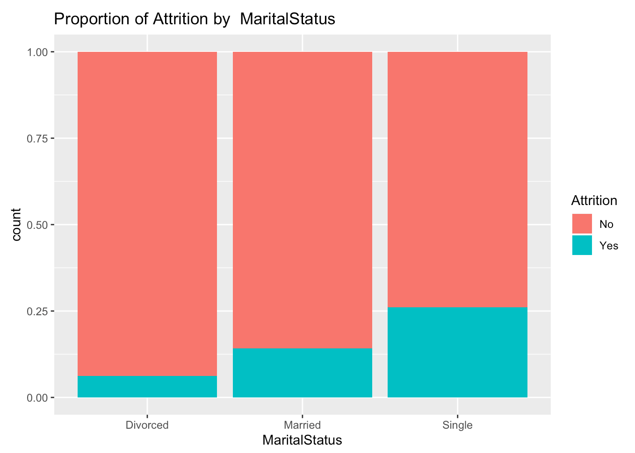
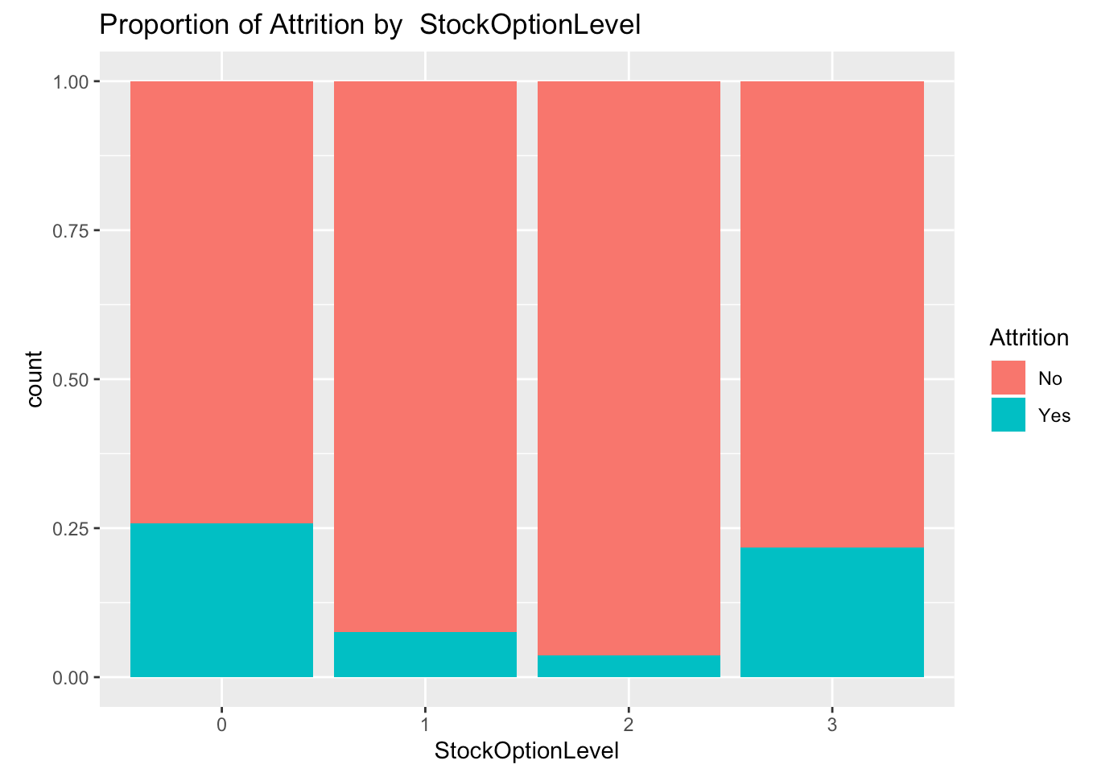
Predicting Attrition

Slide 11
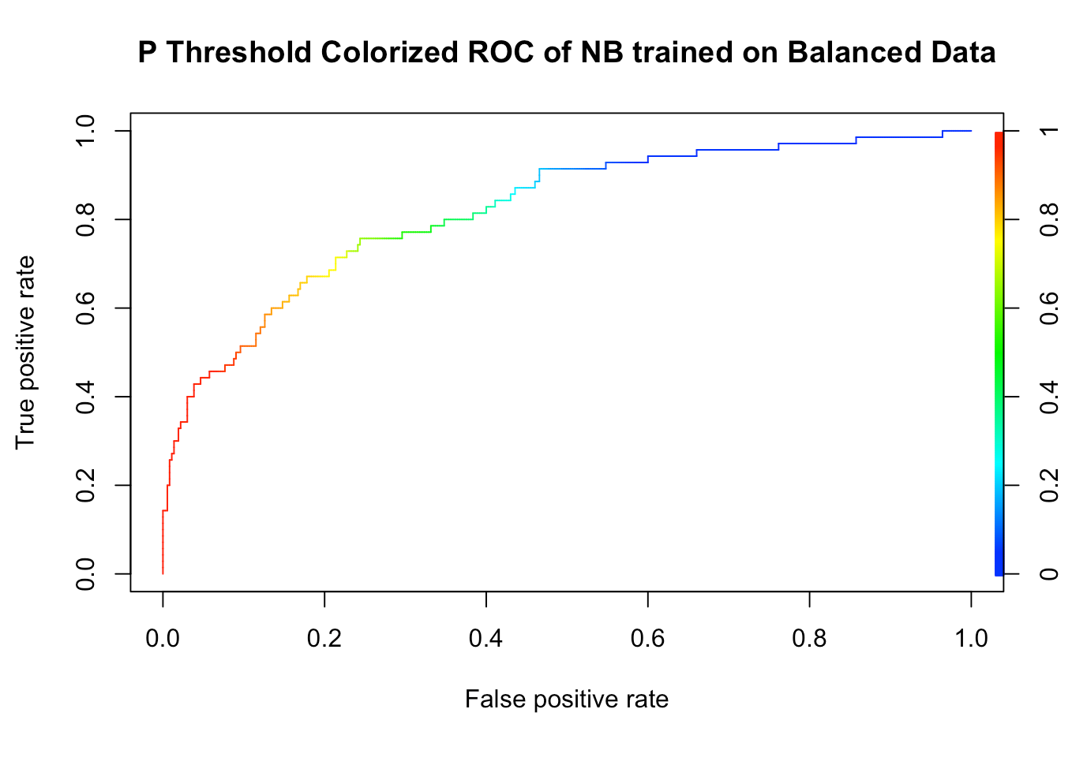
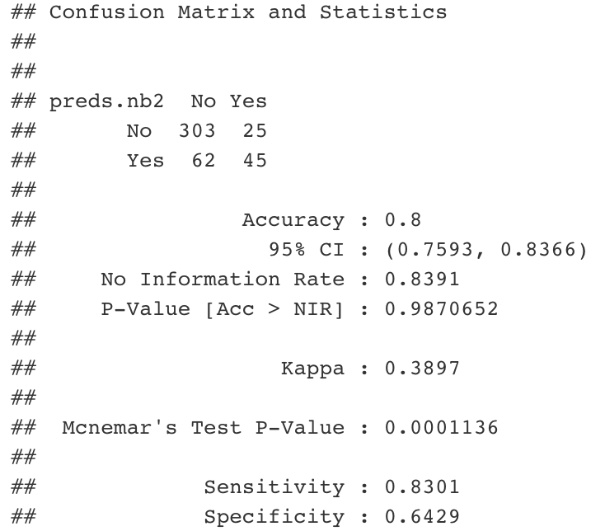
Predicting Attrition
Naïve Bayes model is not bad

Slide 12
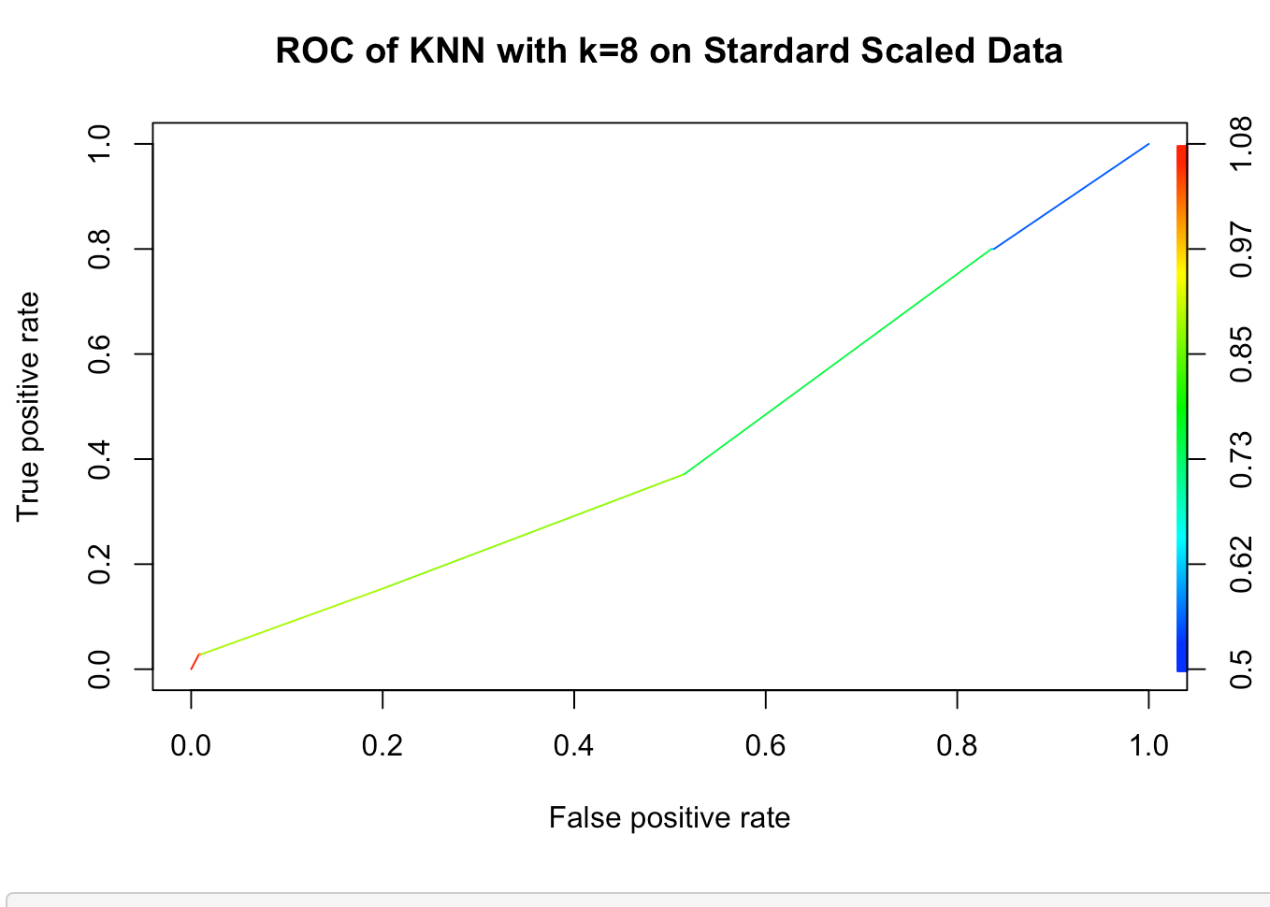
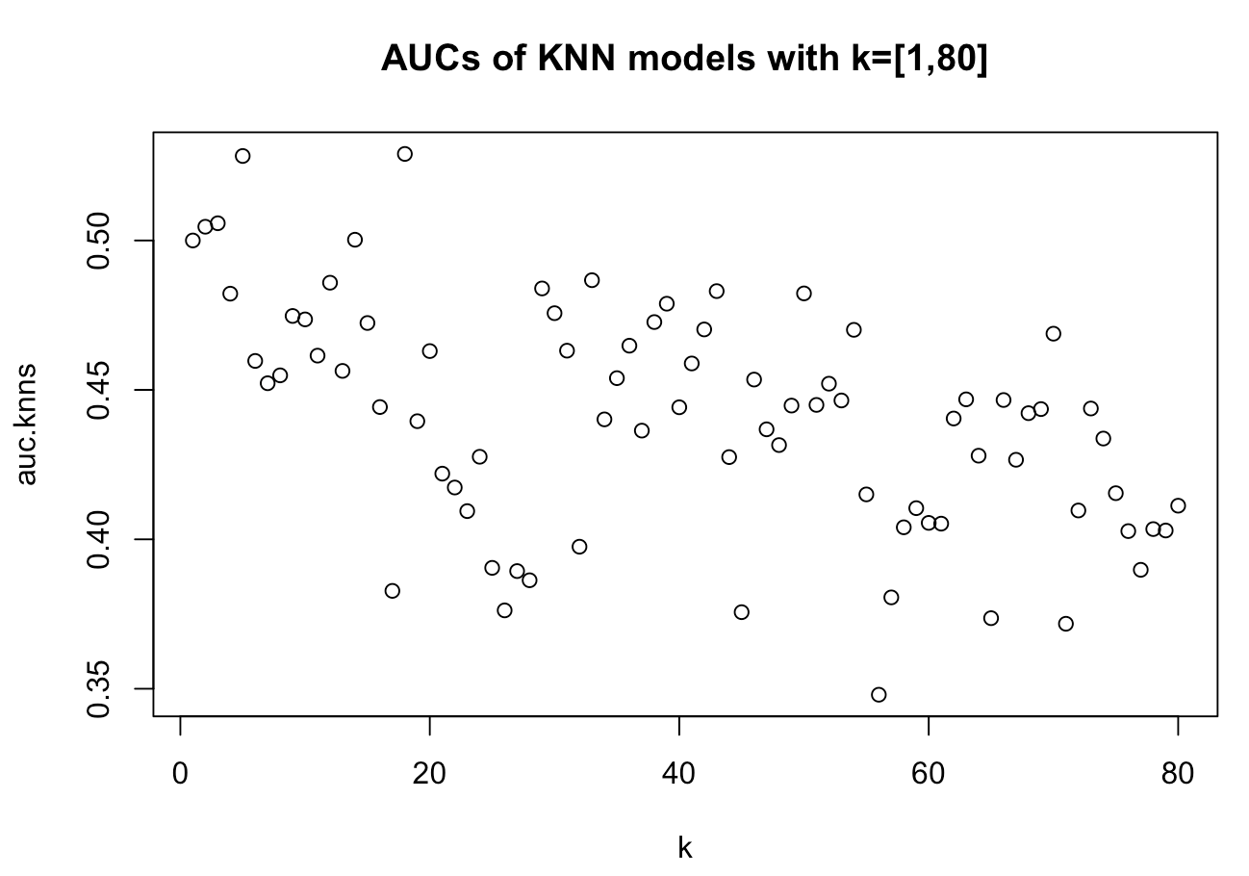
Predicting Attrition
KNN model is terrible

Slide 13
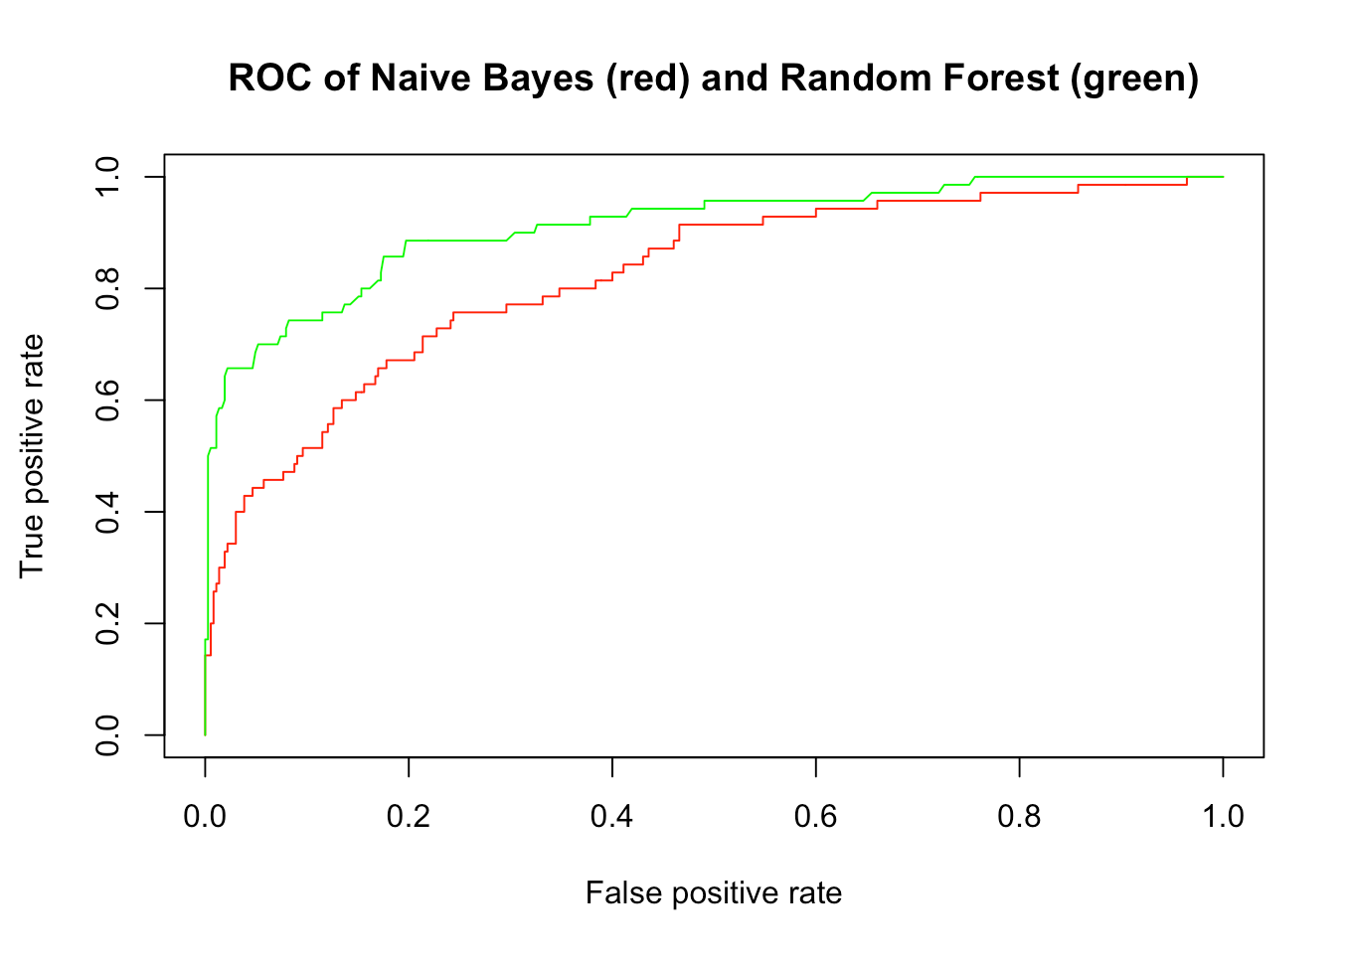
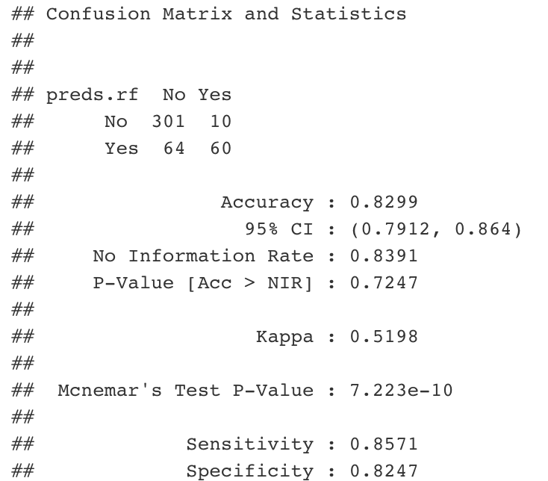
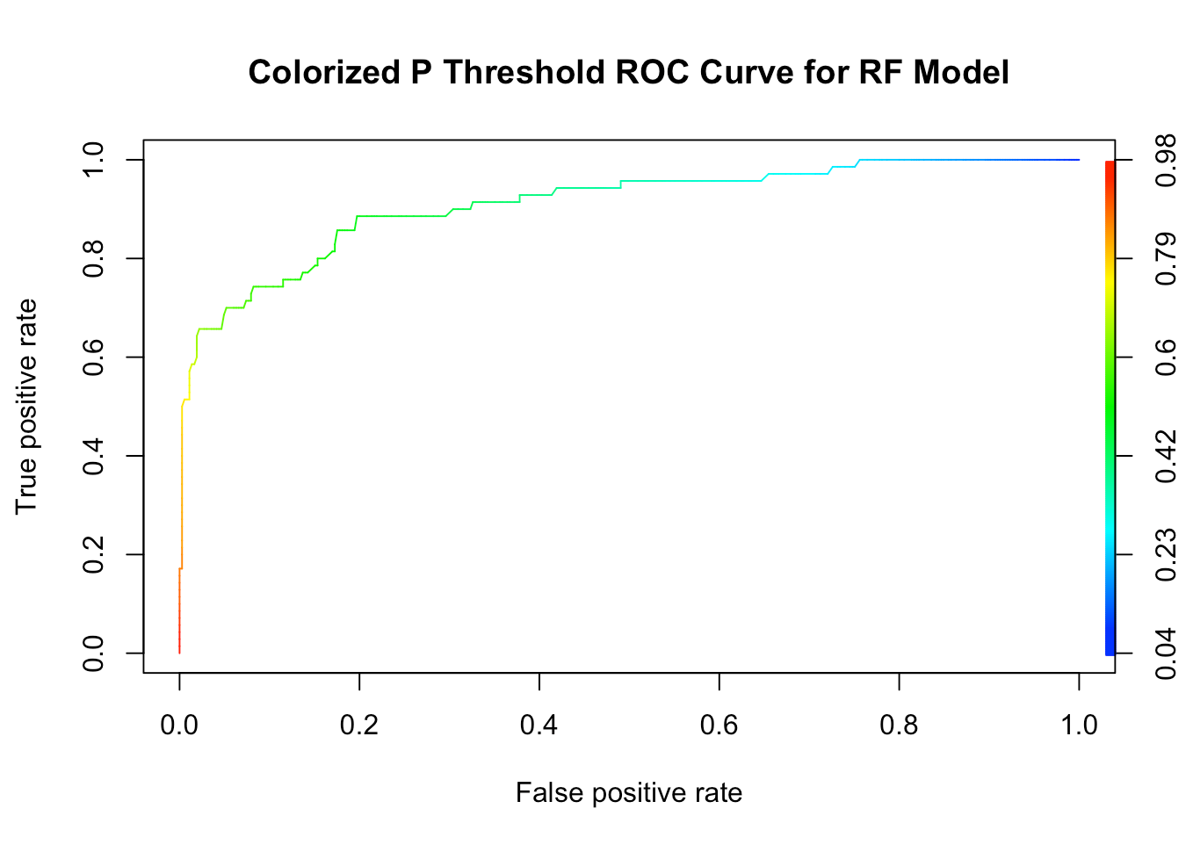
Predicting Attrition
Random forest is the best of our models
Threshold of .5 is good

Slide 14
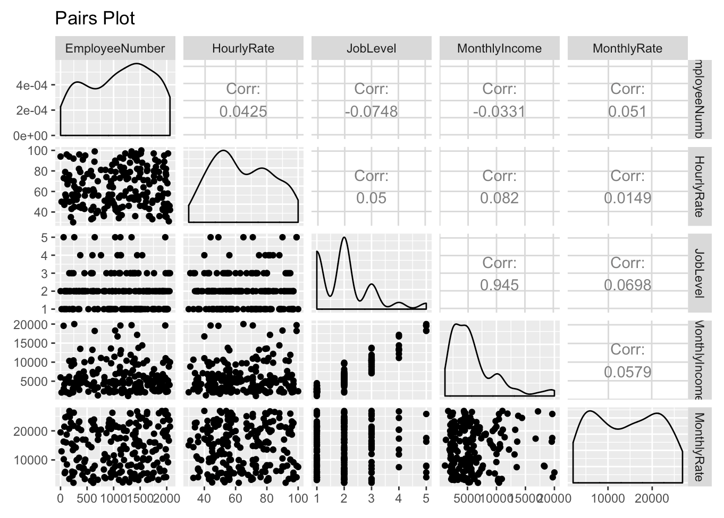
Predicting Salary
Job Level is strong predictor of salary

Slide 15
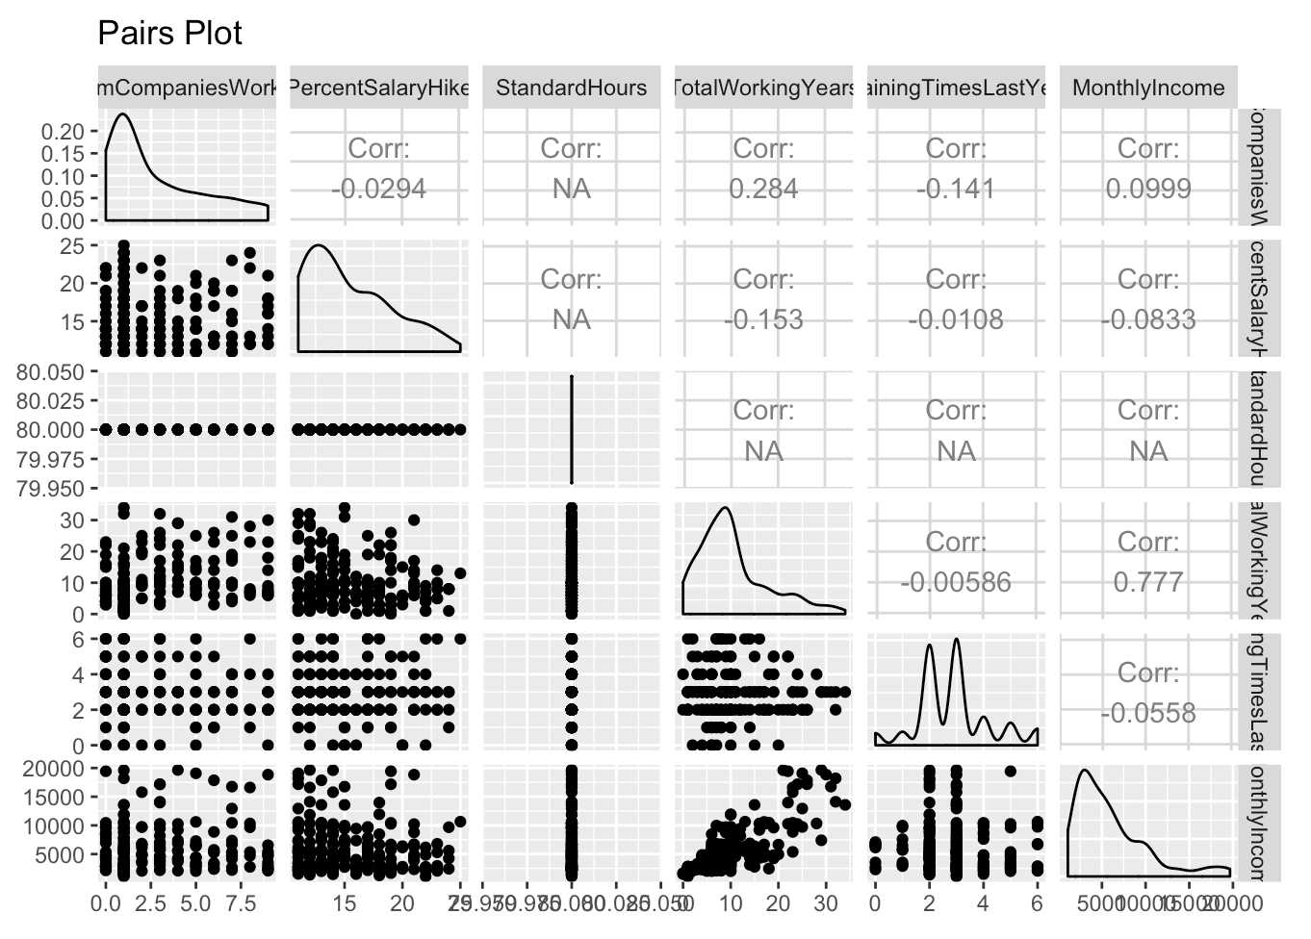
Predicting Salary
Total Working Years is a good predictor of income

Slide 16
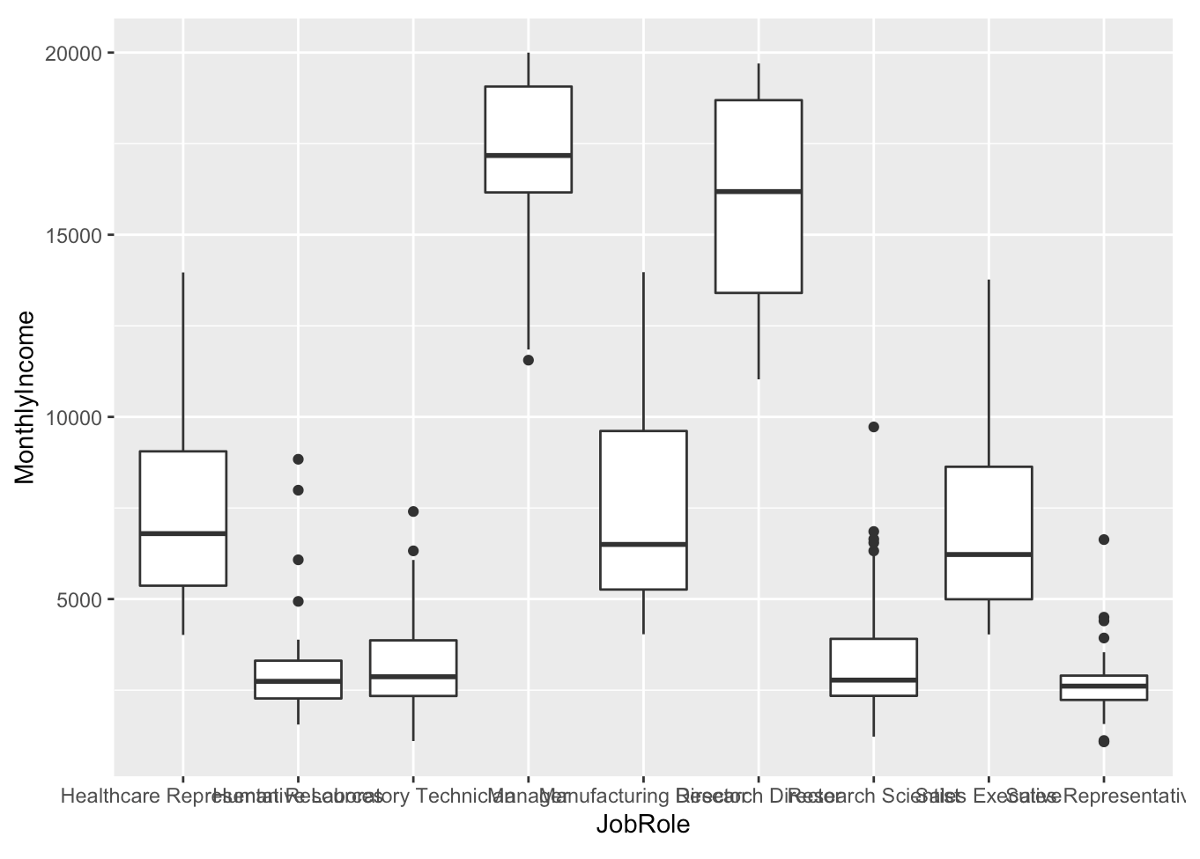
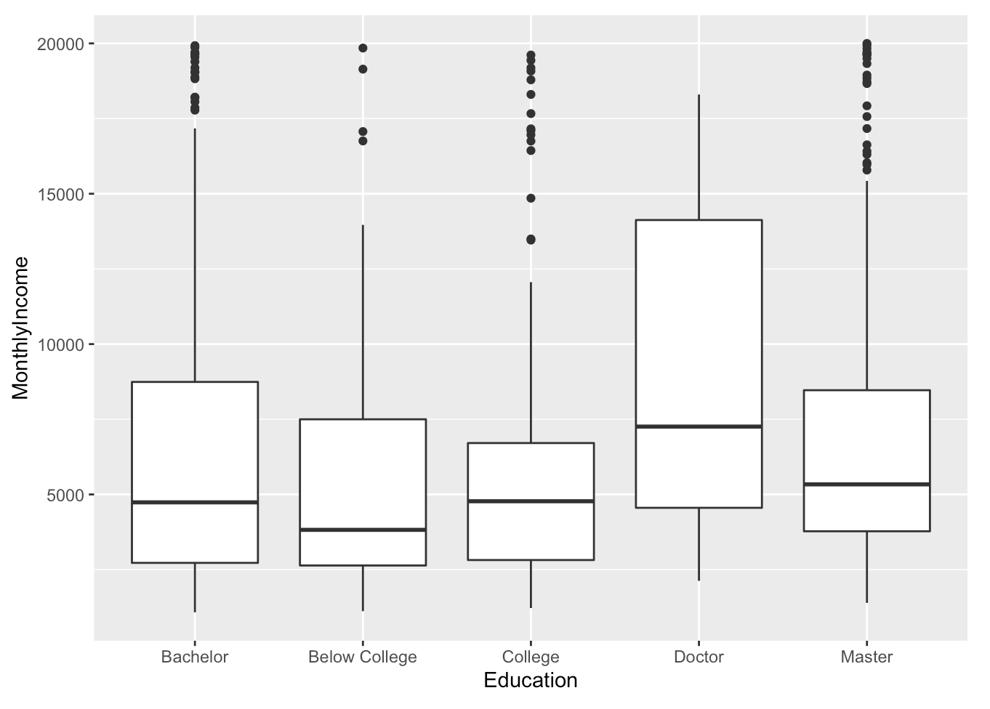
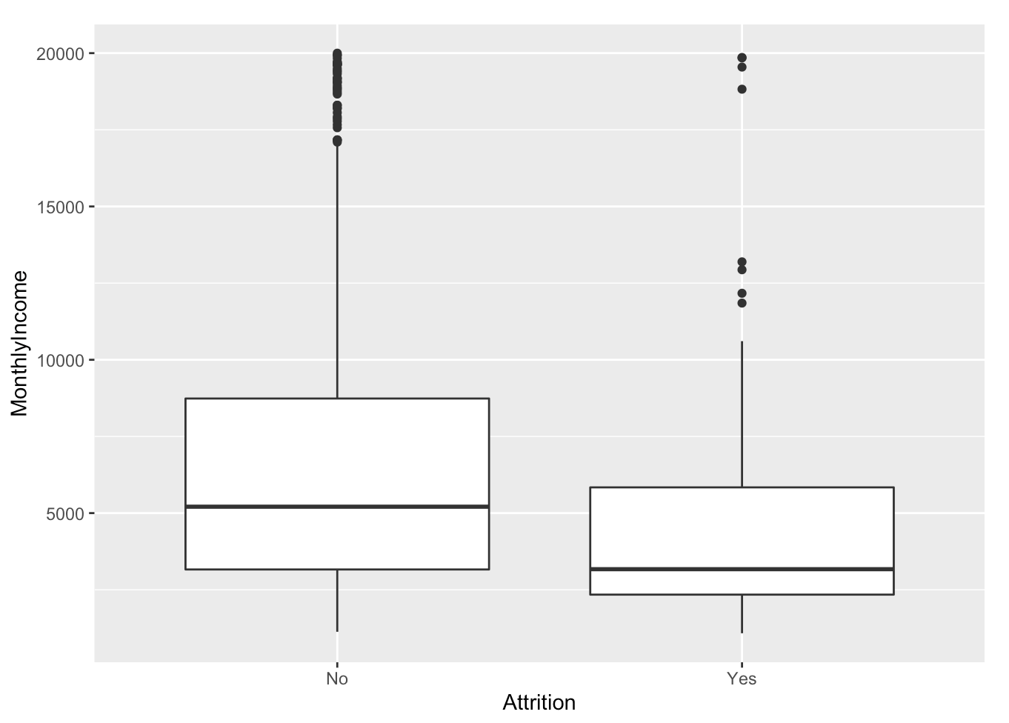
Predicting Salary
Most categorical variables are not very telling about income
Job Role has the most obvious, then a little bit in education and attrition

Slide 17
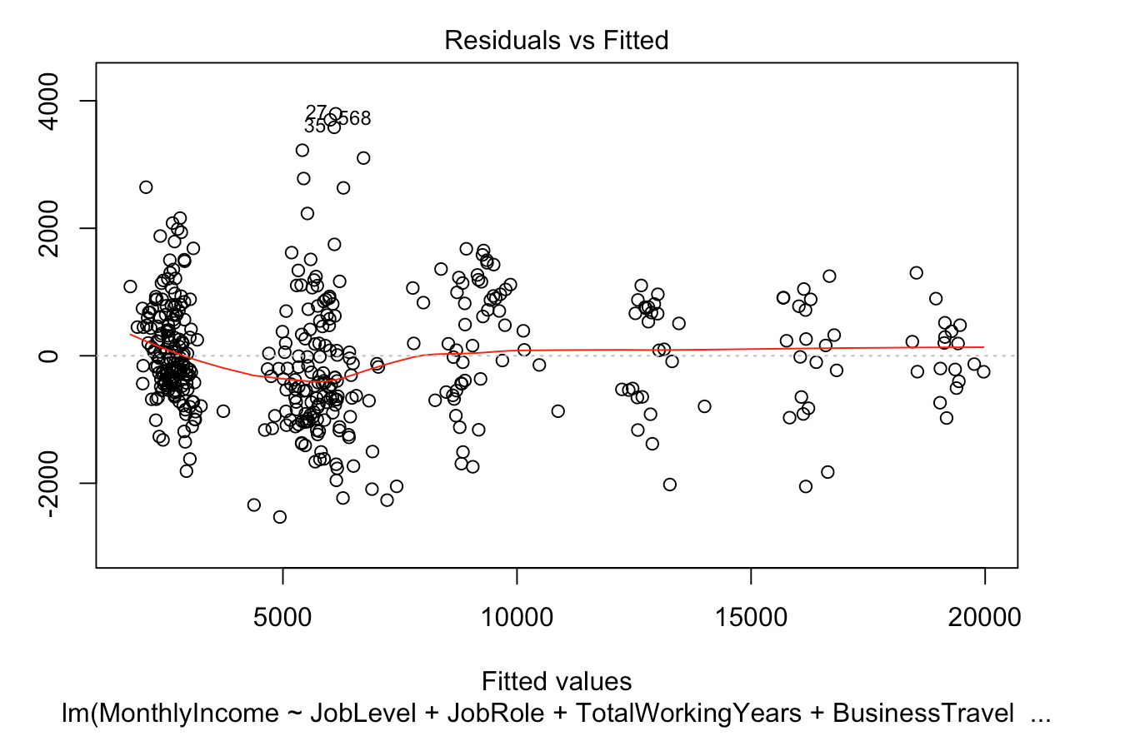
Predicting Salary
Picked a linear model with lowest RMSE out of 4 linear models we tried
MonthlyIncome ~ JobLevel + JobRole + TotalWorkingYears + BusinessTravel + DailyRate + Gender + MonthlyRate + Department + JobRole:TotalWorkingYears + TotalWorkingYears:BusinessTravel
Manual RMSE: 1691
Full RMSE: 1143
LASSO 1 RMSE: 1057
LASSO 2 (with interactions) RMSE: 1026
Forward (with interactions) RMSE: 999

Slide 18
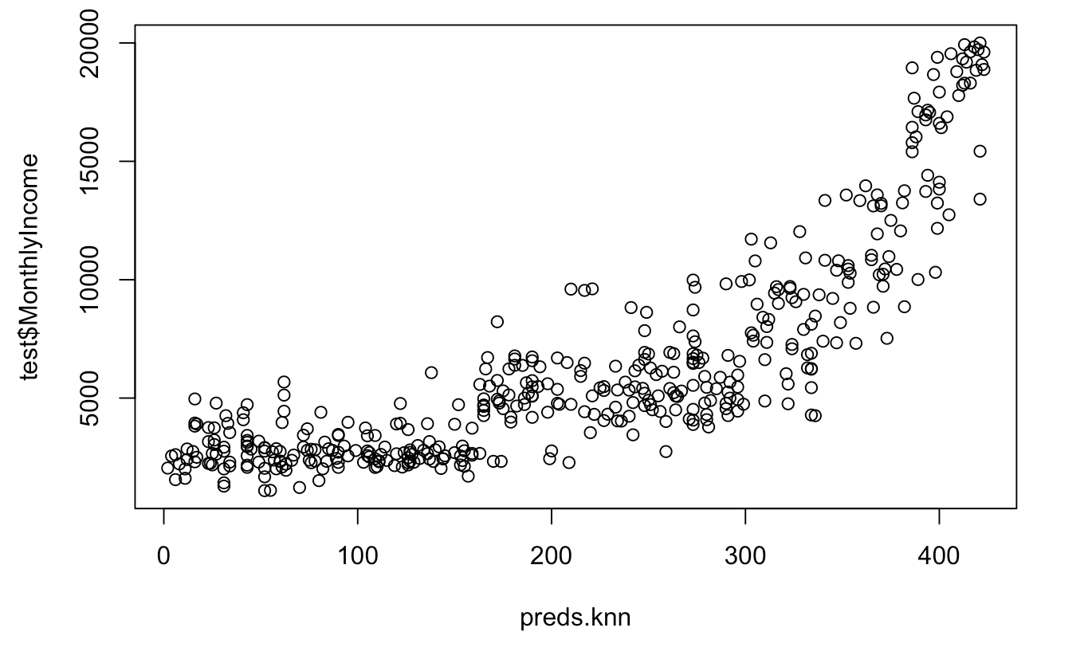
Predicting Salary
KNN was a bad model compared to Linear Regression
Everything RMSE: 7701
Manual RMSE: 7677
JobLevel TotalWorkingYears RMSE: 7675
PCs RMSE: 7685

Slide 19
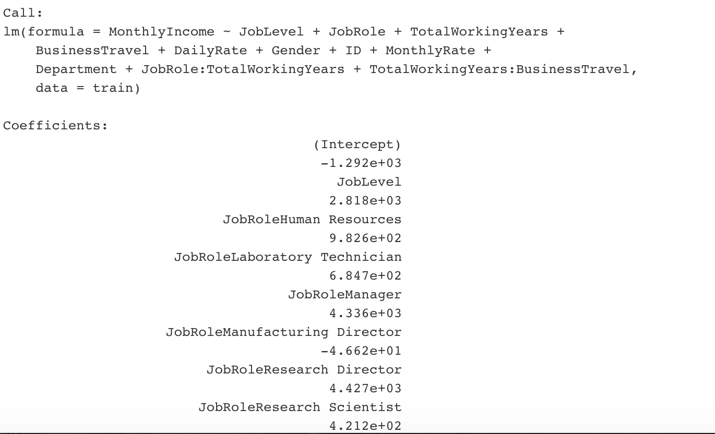
Predicting Salary
Interpretation examples:
TotalWorkingYears: We will ignore this coefficient because we have an interaction term involving TotalWorkingYears
JobRoleHumanResources: On average, a person in the human resources job role makes $863 more than a healthcare representative per month, all else being equal.
TotalWorkingYears:BusinessTravelTravel_Frequently : On average, a person who travels frequently will make $37 less per total year of work than a person who does not travel for work, all else being equal

Slide 20
Conclusion
Job Insights
Predicting Attrition
Job involvement
Overtime
Job Role
Predicting Salary
Job Level
Total working years
Job Role

